Slide 1

Creative computing society

Slide 2
What we do in society
Overall goal of society is finding new applications of computing in diverse fields
Physics
Mathematics
Information technology
Cognitive and sciences
Algorithms
.

Slide 3
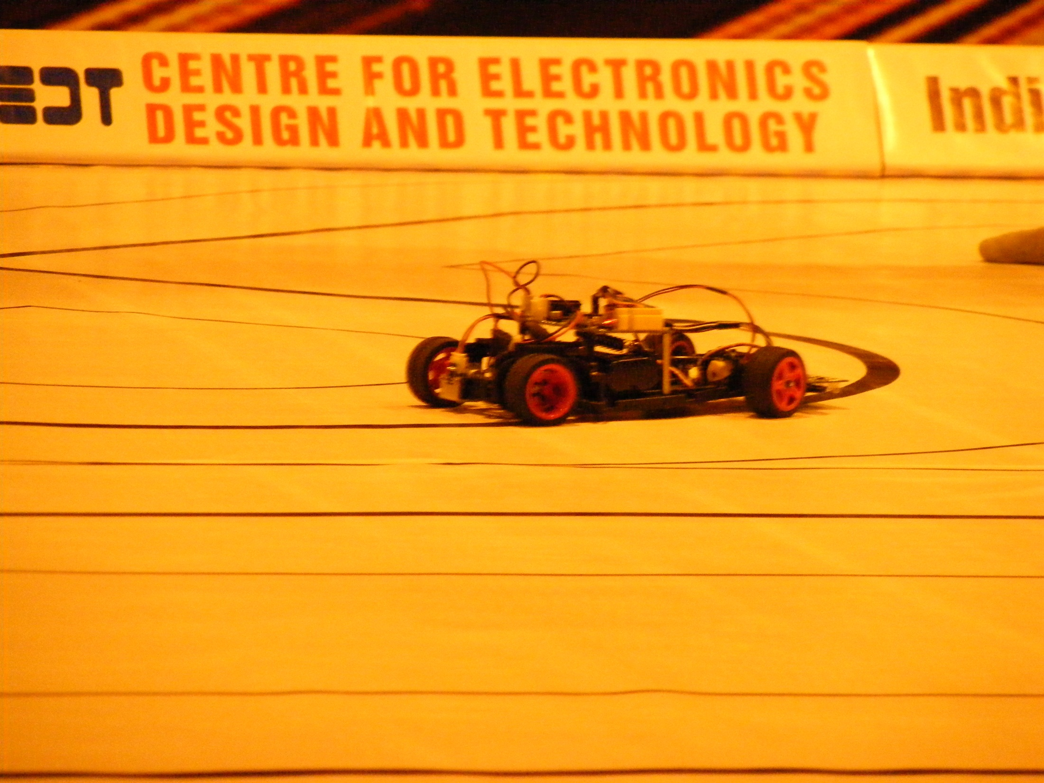
Freescale Smart car based on MC9S12x512 MCU

Slide 4
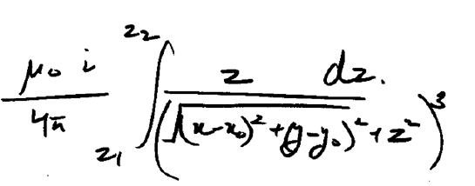

Slide 5
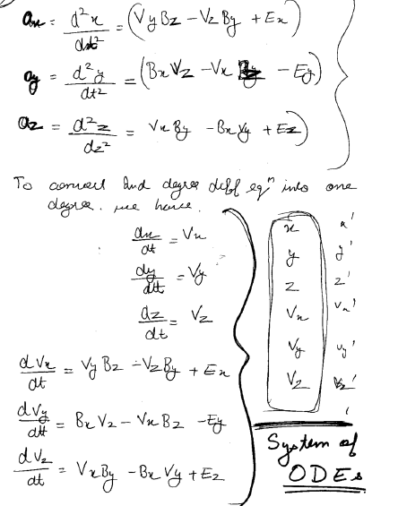
Computing the trajectory of particle in electro-magnetic fields (adaptive simpson quadrature method)

Slide 6
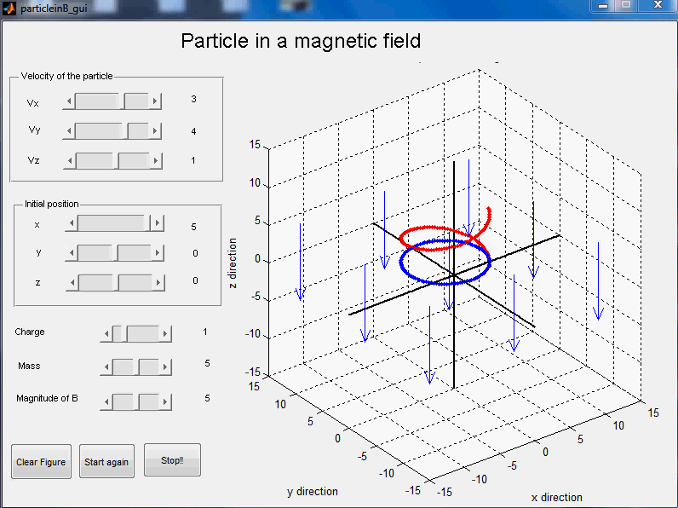

Slide 7
Lorenz equations Butterfly effect

Slide 8
Julia set

Slide 9
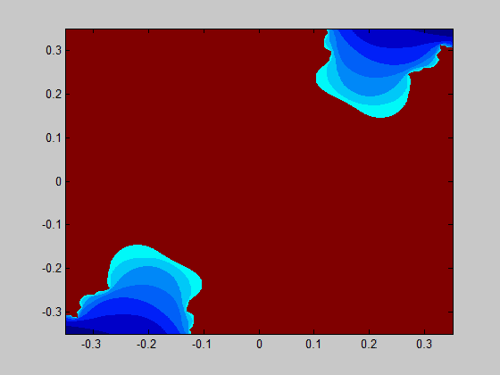
Julia set construction

Slide 10
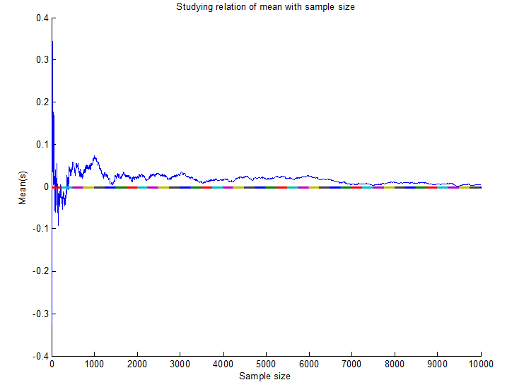
Random nature of Julia set

Slide 11
Mandelbrot set

Slide 12
Julia set random numbers

Slide 13
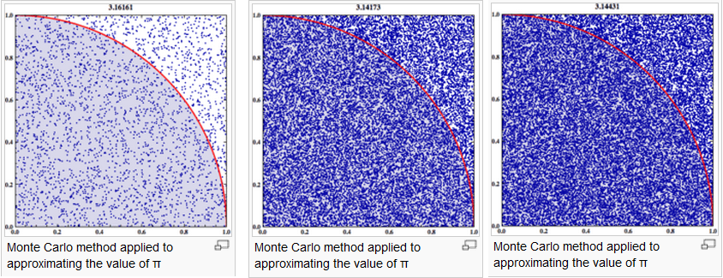
Monti carlo simulations

